Slide 1
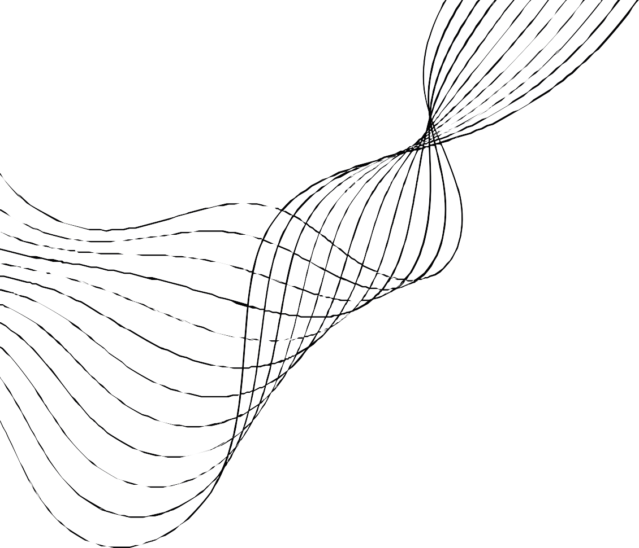
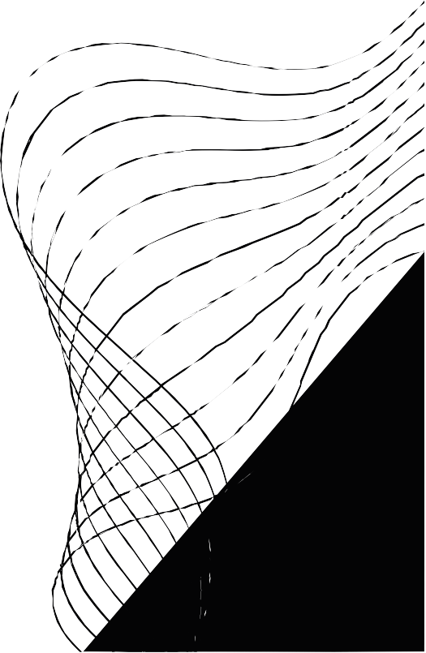
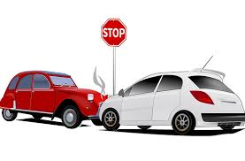
AI/ML Hackathon on Road Safety
Indian Institute of Technology, Roorkee
Problem Statement: Accident Prediction and Prevention
Team: Algorithm Architect
Name: Yashashri Gawande

Slide 2
Contents
Problem Statement
Proposed Approach
Design Specifications
Implementation
Data Visualization
Algorithm Results
Future Scope

Slide 3

Problem Statement
Road accidents pose a substantial threat to public safety, leading to numerous injuries and fatalities worldwide. Predicting the occurrence of road accidents is crucial for implementing preventive measures, optimizing traffic management, and enhancing overall road safety. The goal is to develop a predictive model capable of accurately forecasting the likelihood of road accidents based on various contributing factors and to o provide timely insights to authorities, enabling them to take proactive measures to reduce both the frequency and severity of accidents.

Slide 4
Proposed Approach
In these research we build a model which is able to predict the road accidents based on road traffic accidents. First we considered 32 possible variables which can cause road accidents, these are :-
Time , Day of week, Age band of driver, Sex of driver, Educational level, Vehicle driver relation, Driving experience, Type of vehicle, Owner of vehicle , Service year of vehicle , Defect of vehicle , Area accident occurred, Lanes or Medians, Road alignment, Types of junction, Road surface type , Road surface conditions, Light conditions, Weather conditions, Type of collision, Number of vehicles involved, Number of casualties, Vehicle movement , Casualty class, Sex of casualty , Age band of casualty, Casualty severity, Work of casualty , Fitness of casualty, Pedestrain movement, Cause of-accident, Accident severity

Slide 5
Design Specifications
For model based on machine learning algorithm:
Developer Tools: Jupyter Notebook and Google Colaboratory
Programming Language: Python
Operating System: Windows, Mac and Linux

Slide 6
Implementation using Random Forest Algorithm
Random forest was proposed by Breiman in 2001.
It leverages the power of ensemble learning by combining predictions from multiple decision trees, resulting in a more robust and accurate model.
The algorithm is primarily built upon two key concepts: bagging and random feature selection.
In the bagging process, a new training dataset of size n, denoted as k, is created by uniformly sampling with replacement from the original training set. k base trees are trained using these new training sets.
To introduce diversity among the base trees, a random subset of features is selected for each tree during the training process.

Slide 7
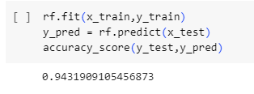
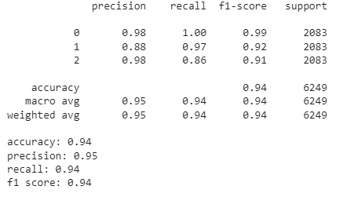
Algorithm Results
Fig: Model Accuracy
The accuracy of random forest algorithm is 94.31%
Fig: Classification Matrix

Slide 8
Future Scope
Real-time Monitoring and Alerts
Collaboration with Smart Cities Initiatives
Predictive Analytics for Accident Severity
Integration of Advanced Technologies

Slide 9
THANK YOU!

